Slide 1

Public Relations
Adam Kistler, Jamesha McClain, Michael Harris

Slide 2
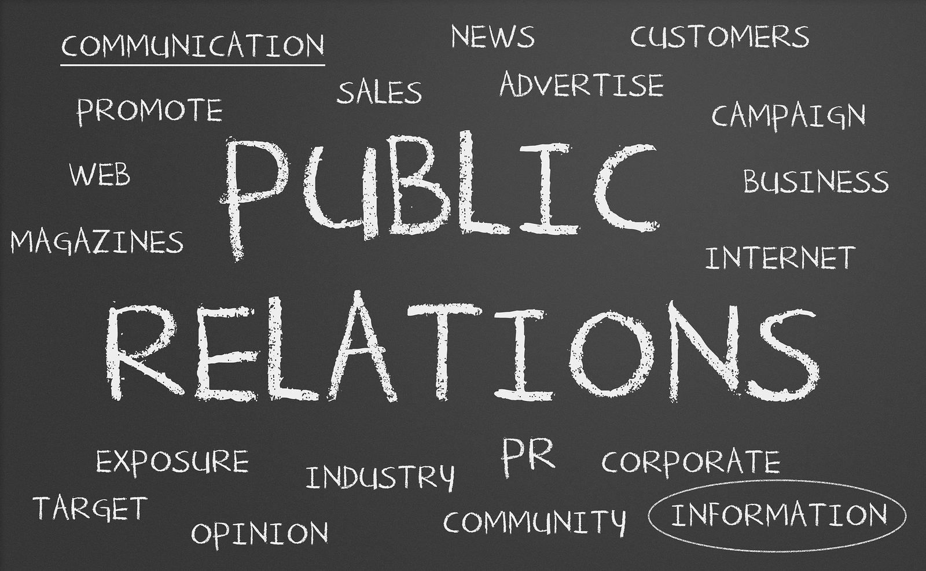
What is Public Relations?
“The actions of a corporation, store, government, individual, etc., in promoting goodwill between itself and the public, the community, employees, customers, etc.”
https://www.dictionary.com/browse/public-relations?s=t
In the past, PR was mostly focused on creating publicity or a sort of hype versus now, the goal is to influence public opinion and behavior to get business results. Public relations is all about influencing behavior.

Slide 3
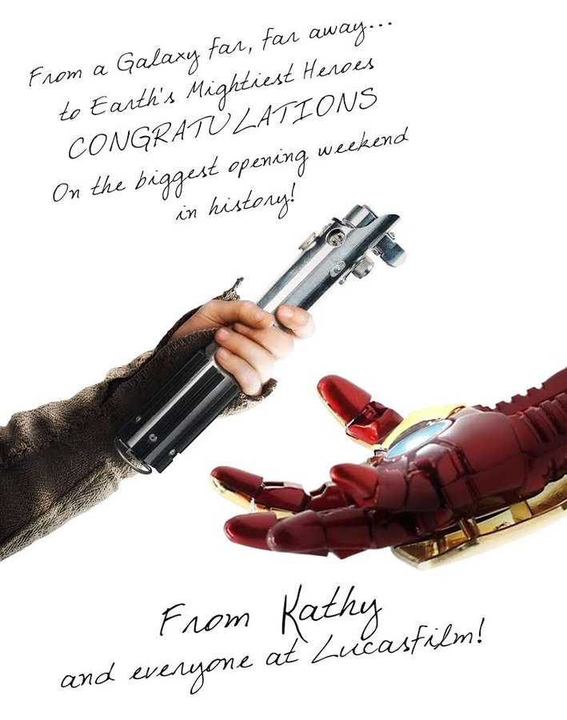
Why public relations?
A good example of public relations is when Avengers: Infinity War broke Star Wars: The Force Awakens’ record for the biggest movie opening weekend. Instead of LucasFilm being upset they that they broke their record, they applauded them for doing something amazing. This led Star Wars to be viewed as respectful and gained them much media attention. If they didn’t handle it the way they did, they would have forfeited many fans and a lot of positive media coverage towards their company.

Slide 4
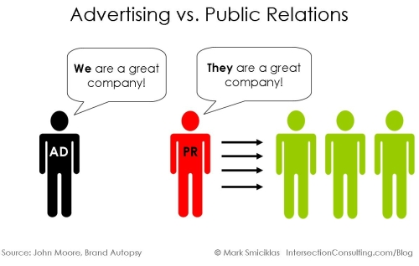
How Public Relations Compares
Public relations is different from advertising in that you need to master skills such as crisis management, internal communications, various issues, and needs to provide communications advice. How you handle a certain issue affects the way the public views you as a company. Whether you handle a situation in a positive or negative way can affect the outlook of your company. Compared to advertising and marketing, in PR, you work on building a good reputation and creating trust with people.

Slide 5

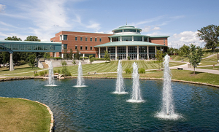
School Hype
Another example of Public Relations is at UMSL a few weeks before school started. They put so much effort and energy into creating hype about the school year during orientation and the kick-off weekend. By doing this, they gave students a positive feeling towards the school year and made us see the school as a fun, enjoyable place. By doing this they influenced the behavior of students in that they will be more motivated to have a good school year.

Slide 6
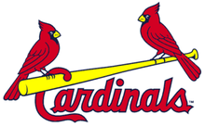
Cardinals games
Cardinals games are all about the hype. They create an overall positive vibe towards the team at the stadium. They play music that pumps you up, encourage comradery between other fans, have a team mascot, shoot shirts into the crowd, etc. What is done outside of the actual game being played is done through public relations. Public relations is crucial to fans having a good time. Without the support and respect of their fans, the team would have nothing.
This Photo by Unknown Author is licensed under CC BY-SA

